Slide 1
NETWORK DESIGN &
ARCHITECTURE
BIT2154 | Assignment 2
Logical Network Architecture Design & Implementation
January 2026 Semester
Name : Takrim Noor Hamim
Student ID: SUKD2501817
Faculty of Engineering, Built Environment and Information Technology
Bachelor of Information Technology (Hons) | SEGi University

Slide 2
01. INTRODUCTION
Purpose & Overview

Slide 3
Introduction
Overview
About This Assignment
Key Objectives
This assignment (Assignment 2) implements the physical network design from Assignment 1 (although I changed the design a little bit in packet tracer) into a fully functional logical network using Cisco Packet Tracer. The network consists of three branches (A, B, C) interconnected via serial WAN links, with each branch configured with VLANs, inter-VLAN routing, RIP v2 routing protocol, wireless access, and comprehensive security measures.
Don’t get confused by seeing the names of the router or switch in the configuration just see the headings of those cause I changes some names after the configuration.
IP Addressing & Subnetting
Assign unique subnets per VLAN per branch VLAN Configuration
VLAN 10 (PCs), VLAN 20 (Server), VLAN 30 (Wi-Fi) Inter-VLAN Routing
Router-on-a-Stick (dot1Q subinterfaces) RIP Version 2
Dynamic routing between all 3 branches Security
Router passwords, banner, port security, unused port shutdown
BIT2154 | Network Design & Architecture | Assignment 2

Slide 4
02. NETWORK TOPOLOGY
Overall Logical Network Diagram

Slide 5
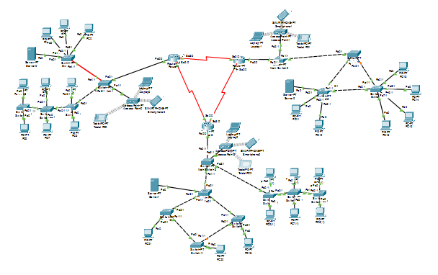
Overall Network Topology — Cisco Packet Tracer
Topology
Full network topology showing Branch A , B, C connected via WAN serial links.
BIT2154 | Network Design & Architecture | Assignment 2

Slide 6
IP Addressing Scheme
IP Config
Subnetting Plan — Per Branch, Per VLAN
Branch | VLAN | Purpose | Network Address | Subnet Mask | Gateway (Router)
Branch A | VLAN 10 | PCs | 192.168.10.0/26 | 255.255.255.192 | 192.168.10.1
Branch A | VLAN 20 | Server | 192.168.10.64/27 | 255.255.255.224 | 192.168.10.65
Branch A | VLAN 30 | Wi-Fi | 192.168.10.96/27 | 255.255.255.224 | 192.168.10.97
Branch B | VLAN 10 | PCs | 192.168.20.0/26 | 255.255.255.192 | 192.168.20.1
Branch B | VLAN 20 | Server | 192.168.20.64/27 | 255.255.255.224 | 192.168.20.65
Branch B | VLAN 30 | Wi-Fi | 192.168.20.96/27 | 255.255.255.224 | 192.168.20.97
Branch C | VLAN 10 | PCs | 192.168.30.0/26 | 255.255.255.192 | 192.168.30.1
Branch C | VLAN 20 | Server | 192.168.30.64/27 | 255.255.255.224 | 192.168.30.65
Branch C | VLAN 30 | Wi-Fi | 192.168.30.96/27 | 255.255.255.224 | 192.168.30.97
WAN A↔B | — | WAN Link | 10.1.2.0/30 | 255.255.255.252 | 10.1.2.1 / 10.1.2.2
WAN A↔C | — | WAN Link | 10.1.1.0/30 | 255.255.255.252 | 10.1.1.1 / 10.1.1.2
WAN B↔C | — | WAN Link | 10.1.3.0/30 | 255.255.255.252 | 10.1.3.1 / 10.1.3.2
BIT2154 | Network Design & Architecture | Assignment 2

Slide 7
03. BRANCH A
Tree Topology (Star and Bus)

Slide 8
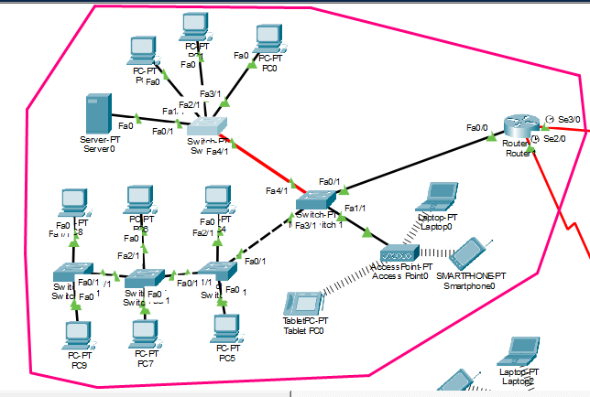
Branch A — Network Topology (Tree – Star and Bus)
Branch A
BIT2154 | Network Design & Architecture | Assignment 2

Slide 9
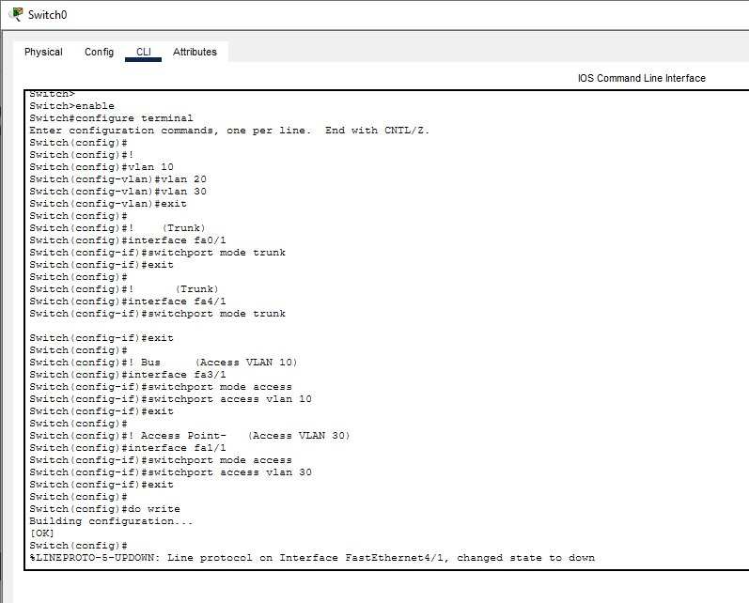
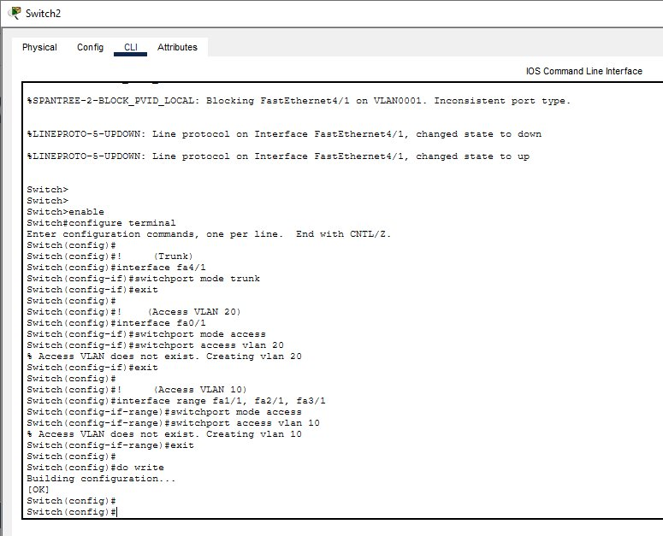
Branch A — Switch VLAN & Trunk Configuration
Branch A
Main Switch (Switch0) — VLANs 10/20/30 created; fa0/1 & fa4/1 set as trunk;
fa3/1=VLAN10 (Bus topology’s line); fa1/1=VLAN30
Star Switch (Switch2) — fa4/1 as trunk; fa0/1=VLAN20; fa1/1, fa2/1, fa3/1=VLAN10
BIT2154 | Network Design & Architecture | Assignment 2

Slide 10
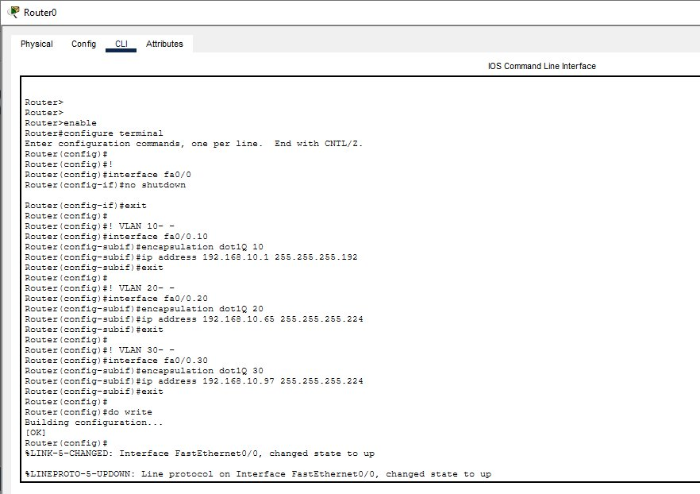
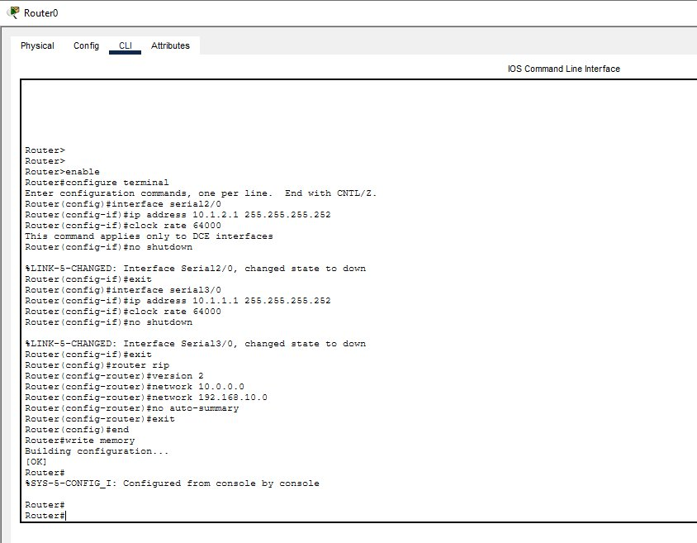
Branch A — Router Inter-VLAN & RIP v2 Configuration
Branch A
Router1 — fa0/0 subinterfaces: VLAN10=192.168.10.1, VLAN20=192.168.10.65, VLAN30=192.168.10.97
Router1 — RIP v2 configured: networks 10.0.0.0 & 192.168.10.0, no auto-summary, serial WAN IPs assigned.
BIT2154 | Network Design & Architecture | Assignment 2

Slide 11
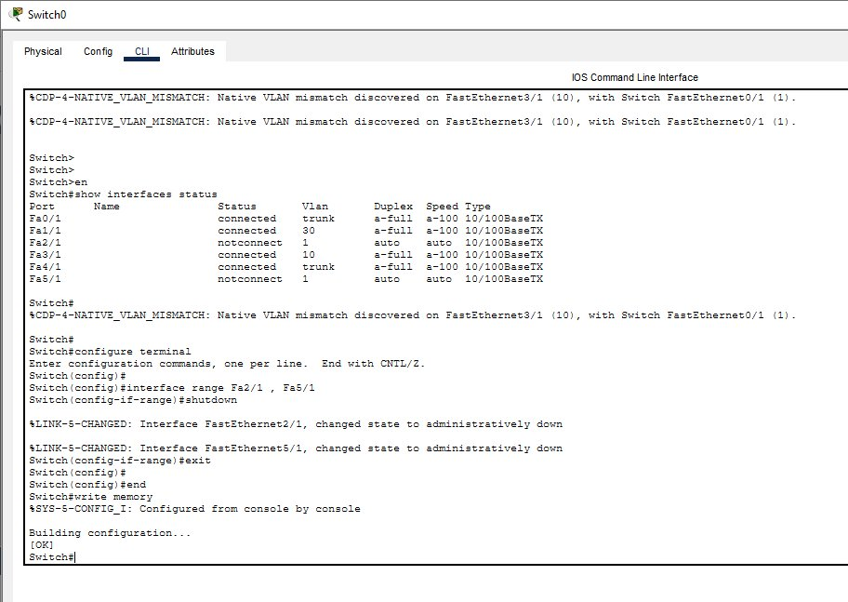
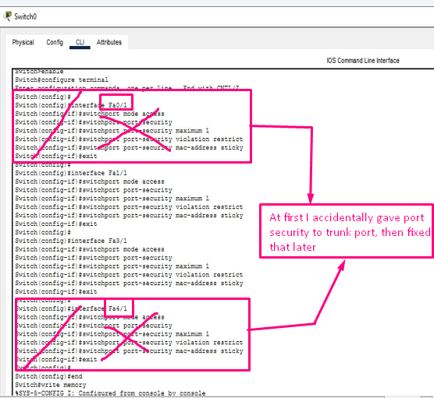
Branch A — Port Security & Unused Port Shutdown
Branch A
Unused ports (fa2/1, fa5/1) shut down to prevent unauthorized access
Port security: max MAC=1, violation=restrict, sticky MAC on fa1/1, fa3/1
BIT2154 | Network Design & Architecture | Assignment 2

Slide 12
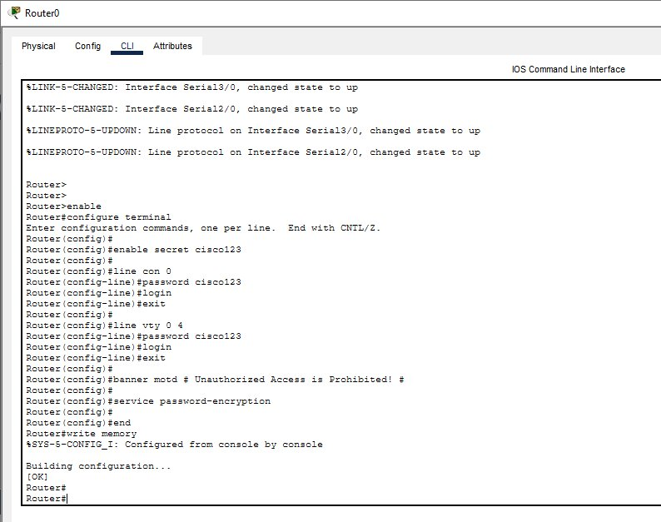
Branch A — Router Security Configuration
Branch A
Router1 security: enable secret, console password, VTY (telnet) password (cisco123), banner MOTD, service password-encryption all configured.
BIT2154 | Network Design & Architecture | Assignment 2

Slide 13
04. BRANCH B
Hybrid Topology (Mesh and Star)

Slide 14
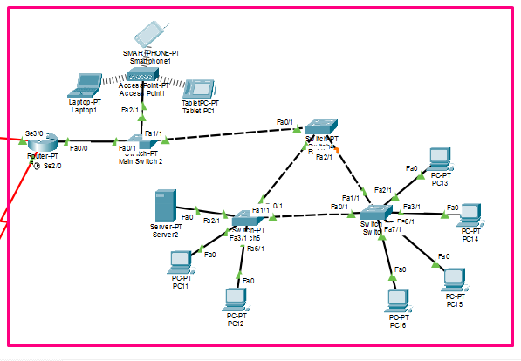
Branch B — Network Topology (Hybrid – Mesh and Star)
Branch B
Also Did the same
configurations for
Branch B
BIT2154 | Network Design & Architecture | Assignment 2

Slide 15
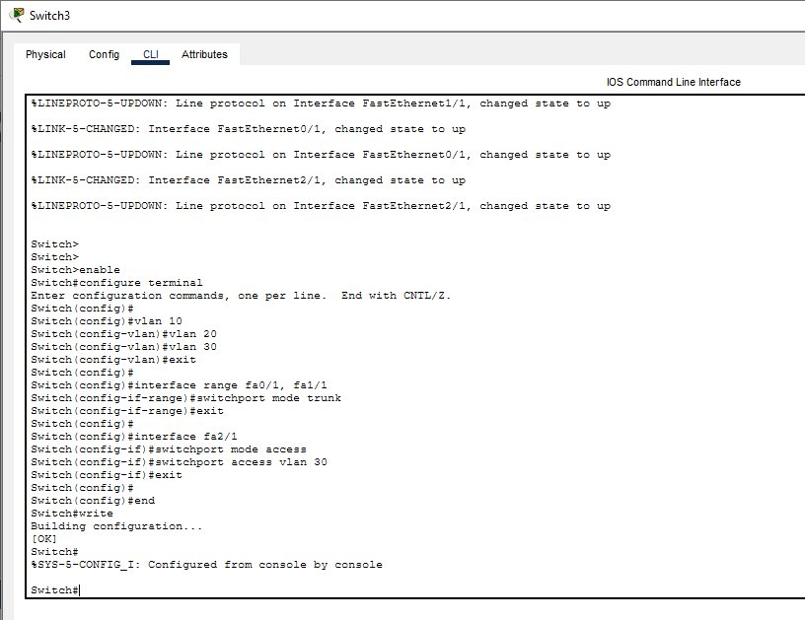
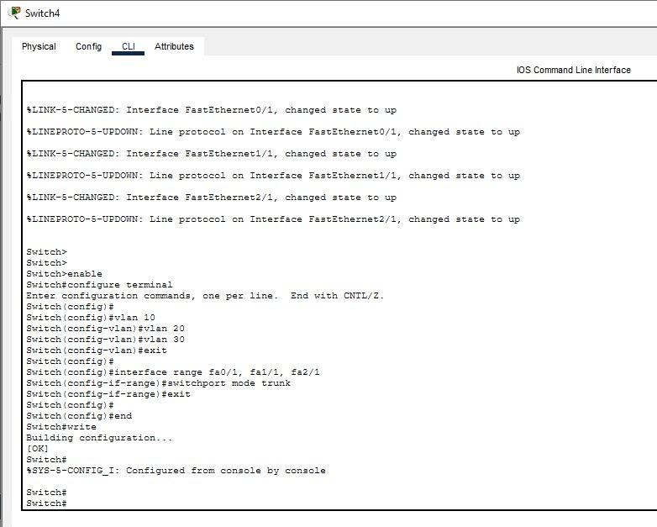
Branch B — Switch VLAN & Trunk Configuration (Main & Top Mesh Switches)
Main Switch (Switch3) — VLANs 10/20/30 created; fa0/1 & fa1/1 trunk;
fa2/1=VLAN30 (Access Point); fa3/1, fa6/1=VLAN10
Top Mesh Switch (Switch4) — fa0/1, fa1/1, fa2/1 all set as trunk ports (mesh interconnects)
BIT2154 | Network Design & Architecture | Assignment 2

Slide 16
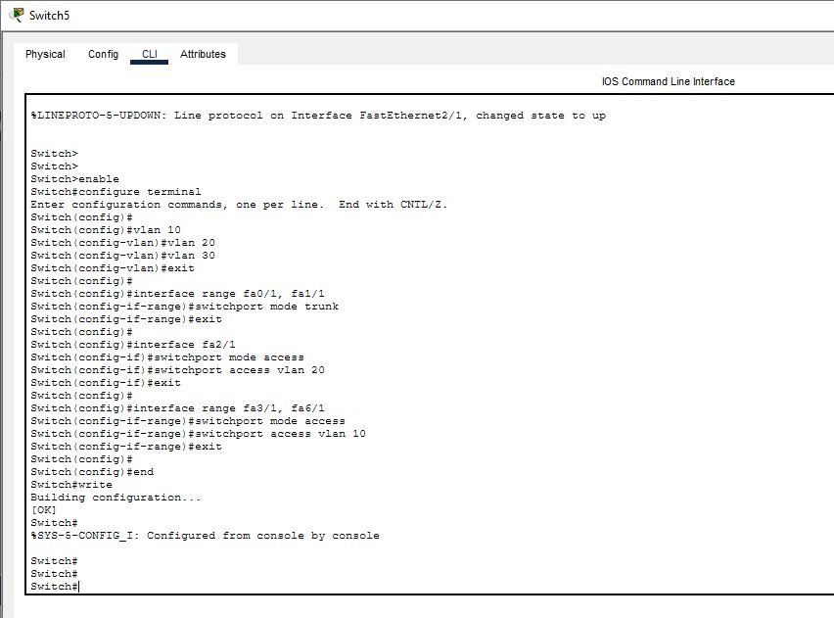
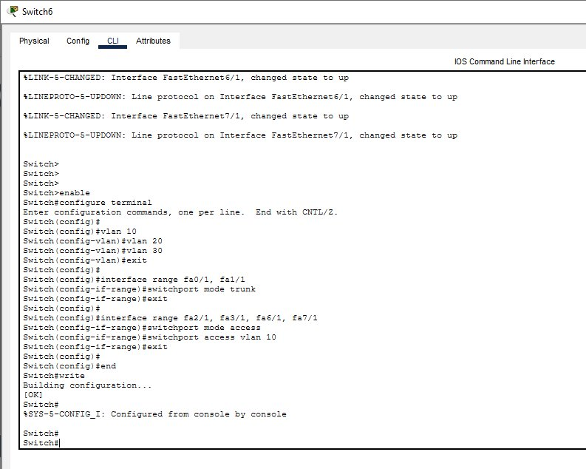
Branch B — Switch VLAN & Trunk Configuration (Left & Right Mesh Switches)
Left Mesh Switch (Switch5) — fa0/1 & fa1/1 trunk;
fa2/1=VLAN20 (Server); fa3/1, fa6/1=VLAN10
Right Mesh Switch (Switch6) — fa0/1 & fa1/1 trunk; fa2/1, fa3/1, fa6/1, fa7/1=VLAN10
BIT2154 | Network Design & Architecture | Assignment 2

Slide 17
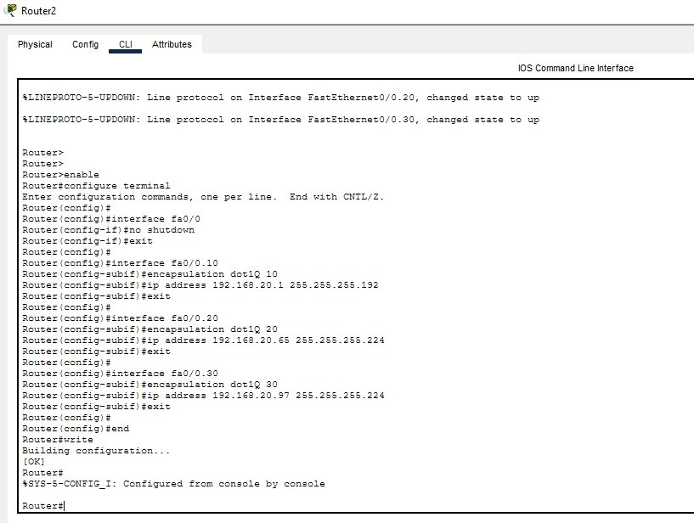
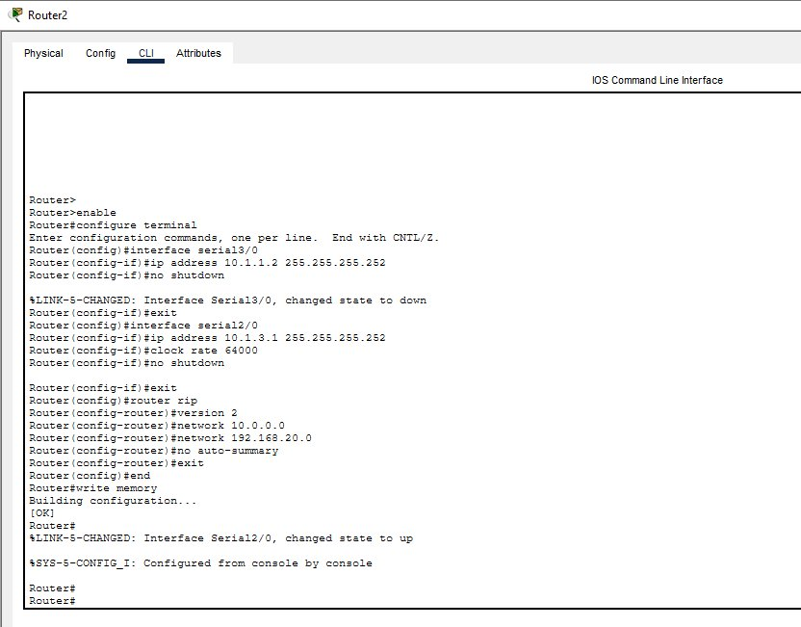
Branch B — Router Inter-VLAN & RIP v2 Configuration
Branch B
Router2 — fa0/0 subinterfaces: VLAN10=192.168.20.1, VLAN20=192.168.20.65, VLAN30=192.168.20.97
Router2 — RIP v2: networks 10.0.0.0 & 192.168.20.0, serial3/0=10.1.1.2, serial2/0=10.1.3.1
BIT2154 | Network Design & Architecture | Assignment 2

Slide 18
Branch B — Port Security & Unused Port Shutdown
Branch B
✅ What Was Done
Same port security configuration applied as Branch A:
• switchport mode access
• switchport port-security
• port-security maximum 1
• violation restrict
• mac-address sticky
• Unused ports shut down
⚠️ Problem Encountered
Initially, port security was accidentally applied to trunk ports also. This caused ping failures between VLANs as trunk ports should not have port-security. The fix was to remove port-security from trunk ports and apply it only to access ports.
📷 Note
Screenshot of the corrected configuration was not captured at the time of fixing.
Missing
Screenshot
BIT2154 | Network Design & Architecture | Assignment 2

Slide 19

Branch B — Router Security Configuration
Branch B
Router2 security: enable secret, console password, VTY password (cisco123), banner MOTD 'Unauthorized Access is Prohibited!', service password-encryption.
BIT2154 | Network Design & Architecture | Assignment 2

Slide 20
05. BRANCH C
Hybrid Topology – Bus and Ring

Slide 21
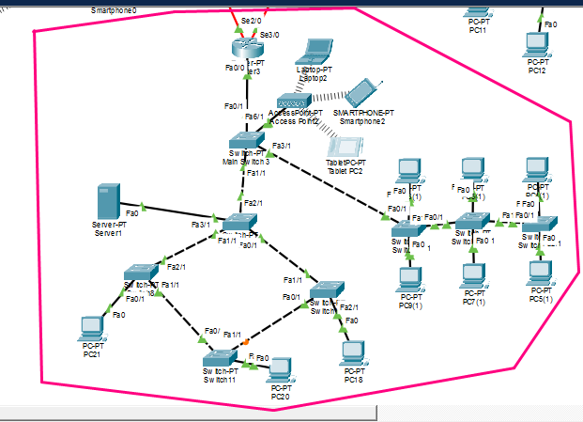
Branch C — Network Topology (Ring)
Branch C
Also Did the
configurations for
Branch C
(Same way)
BIT2154 | Network Design & Architecture | Assignment 2

Slide 22
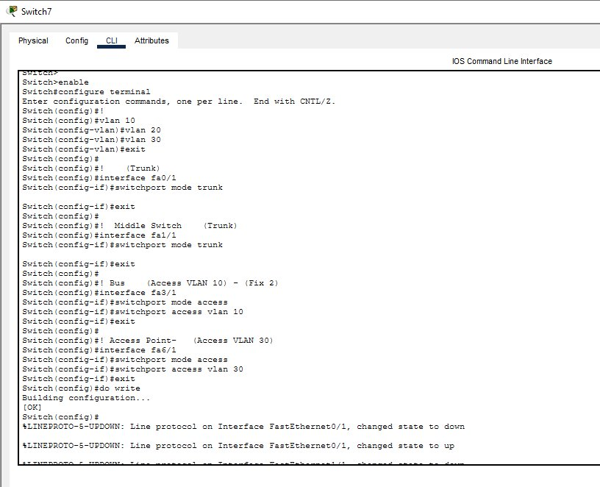
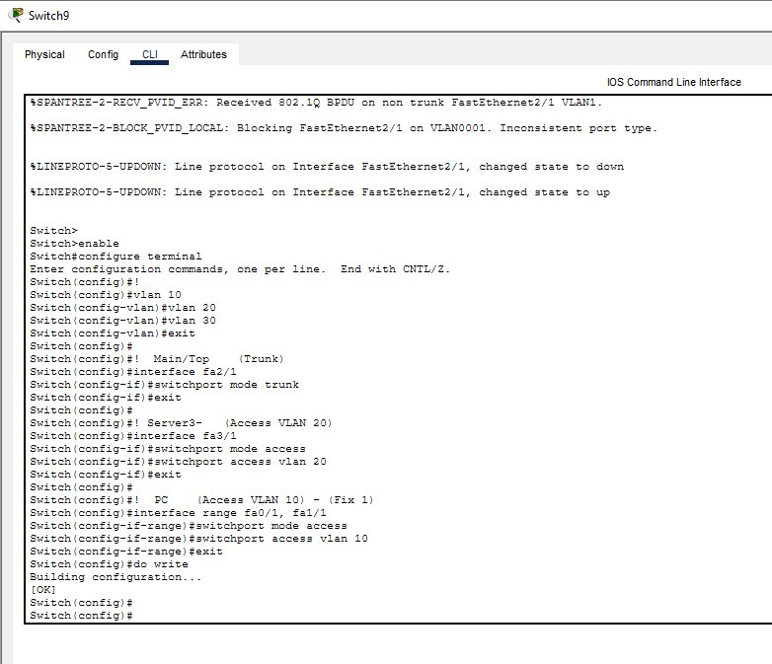
Branch C — Switch VLAN & Trunk Configuration
Branch C
Main Switch (Switch7/9) — VLANs 10/20/30 created; fa0/1 trunk;
fa3/1=VLAN20 (Server); fa0/1, fa1/1=VLAN10; fa6/1=VLAN30
Top Ring Switch — fa2/1 trunk; fa3/1=VLAN20 (Server); fa0/1, fa1/1=VLAN10 PCs
BIT2154 | Network Design & Architecture | Assignment 2

Slide 23
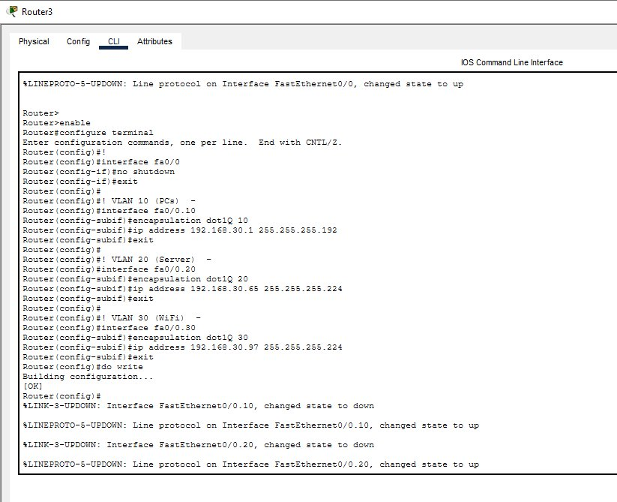
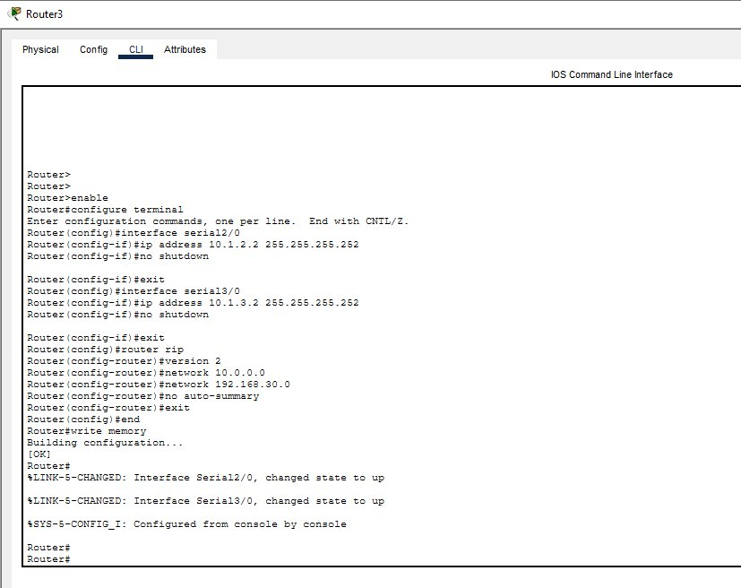
Branch C — Router Inter-VLAN & RIP v2 Configuration
Branch C
Router3 — fa0/0 subinterfaces: VLAN10=192.168.30.1,
VLAN20=192.168.30.65, VLAN30=192.168.30.97
Router3 — RIP v2: networks 10.0.0.0 & 192.168.30.0, serial2/0=10.1.2.2, serial3/0=10.1.3.2
BIT2154 | Network Design & Architecture | Assignment 2

Slide 24
Branch C — Port Security & Unused Port Shutdown
Branch C
✅ What Was Done
Same port security configuration applied as Branch A:
• switchport mode access
• switchport port-security
• port-security maximum 1
• violation restrict
• mac-address sticky
• Unused ports shut down
⚠️ Problem Encountered
Initially, port security was accidentally applied to trunk ports also. This caused ping failures between VLANs as trunk ports should not have port-security. The fix was to remove port-security from trunk ports and apply it only to access ports.
📷 Note
Screenshot of the corrected configuration was not captured at the time of fixing.
Missing
Screenshot
BIT2154 | Network Design & Architecture | Assignment 2

Slide 25
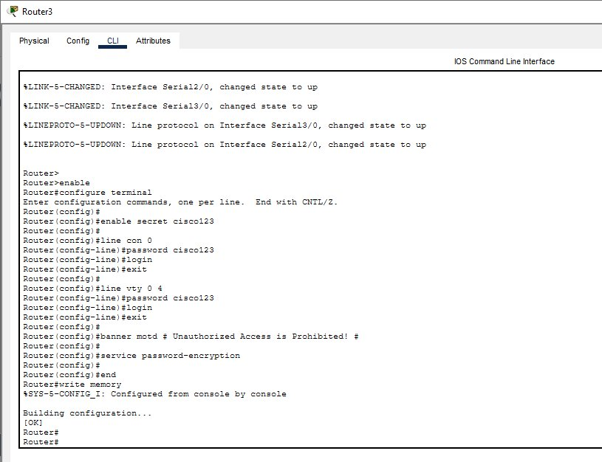
Branch C — Router Security Configuration
Branch C
Router3 security: enable secret, console password, VTY password (cisco123), banner MOTD 'Unauthorized Access is Prohibited!', service password-encryption.
BIT2154 | Network Design & Architecture | Assignment 2

Slide 26
06. SECURITY CONFIGURATION
Router & Switch Security

Slide 27
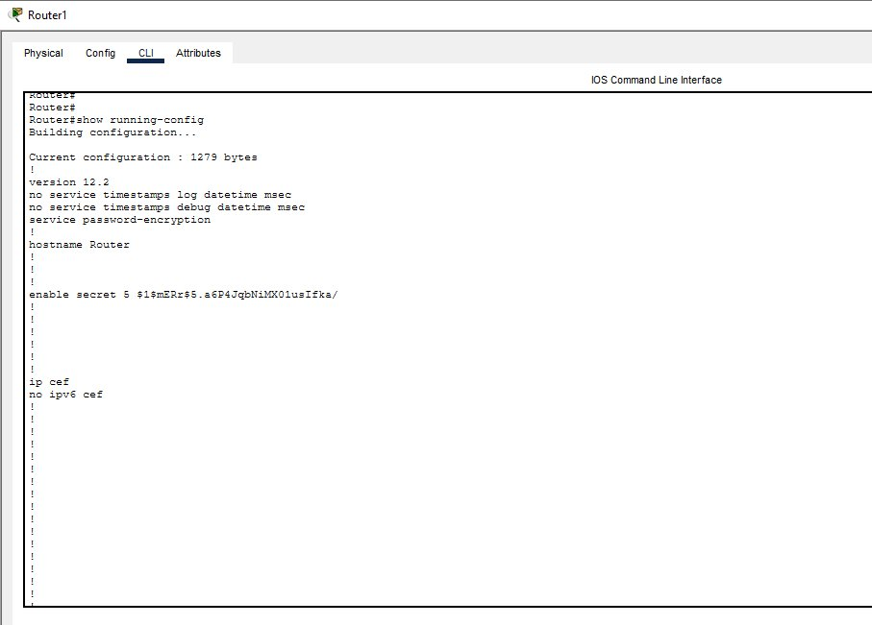
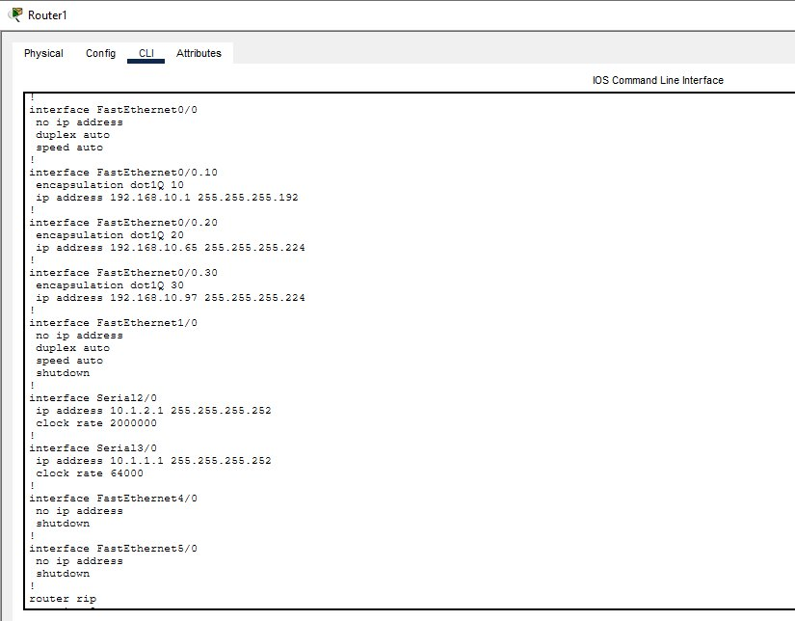
Security — Router Running Config (Part 1 & 2)
Security
service password-encryption enabled; enable secret stored as MD5 hash (Type 5)
Subinterface IPs, serial WAN IPs, RIP v2 configuration confirmed in running-config
BIT2154 | Network Design & Architecture | Assignment 2

Slide 28
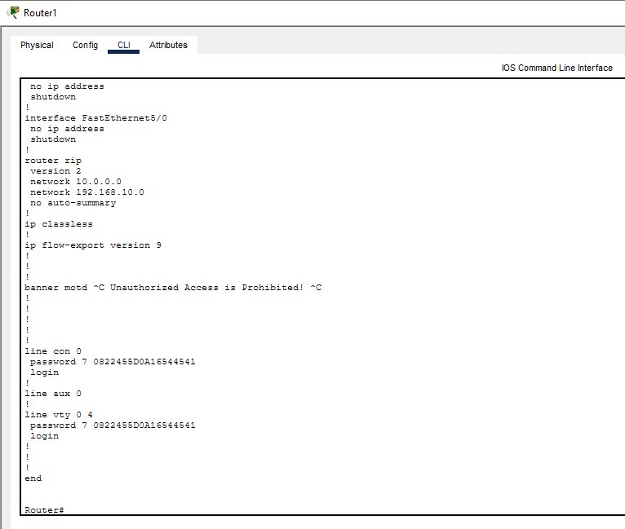
Security — Router Running Config (Part 3)
Security
Banner MOTD: 'Unauthorized Access is Prohibited!'; line con 0 & line vty 0 4 passwords encrypted (Type 7); login required.
BIT2154 | Network Design & Architecture | Assignment 2

Slide 29
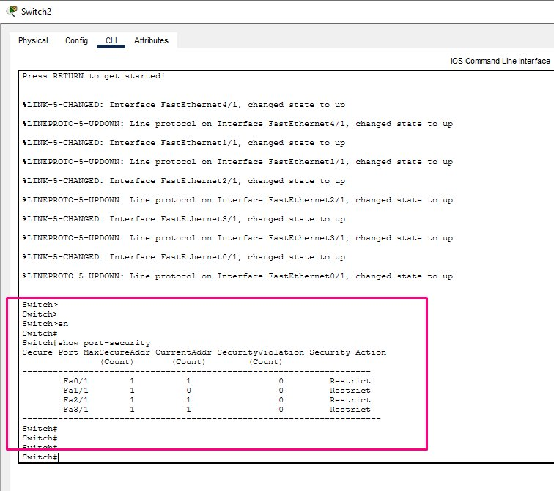
Security — Switch Port Security on a Random Switch
Security
show port-security: MaxSecureAddr=1, SecurityViolation=Restrict on Fa0/1, Fa1/1, Fa2/1, Fa3/1. Sticky MAC learning active.
BIT2154 | Network Design & Architecture | Assignment 2

Slide 30
07. TESTING & VERIFICATION
Ping Tests, Routing Tables & VLAN Tables

Slide 31
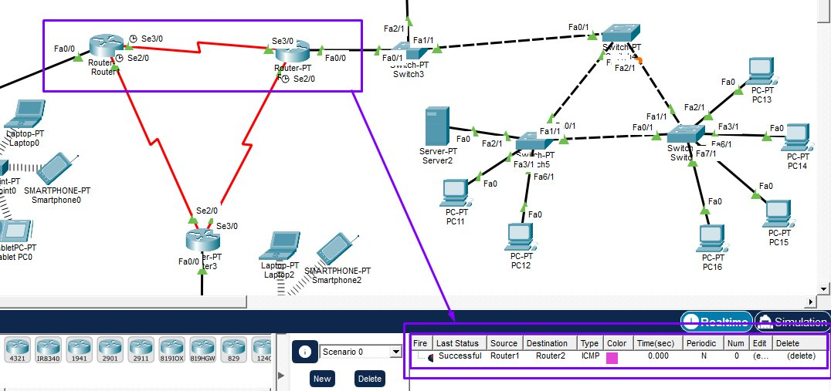
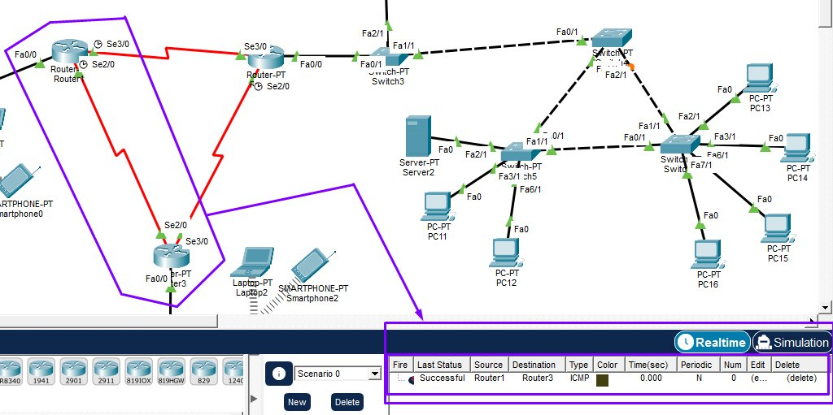
Testing — Inter-Branch Ping (Branch A → B & A → C)
Testing
✅ Router1 (Branch A) → Router2 (Branch B): ICMP Successful
✅ Router1 (Branch A) → Router3 (Branch C): ICMP Successful
BIT2154 | Network Design & Architecture | Assignment 2

Slide 32
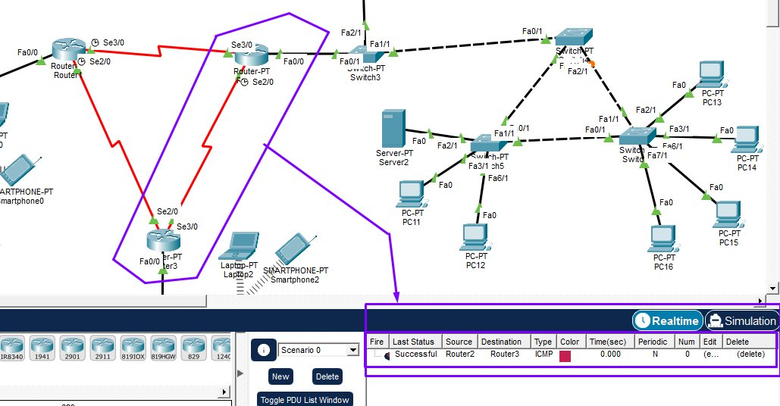
Testing — Inter-Branch Ping (Branch B → C)
Testing
✅ Router2 (Branch B) → Router3 (Branch C): ICMP Successful — All 3 branches fully interconnected via RIP v2.
BIT2154 | Network Design & Architecture | Assignment 2

Slide 33
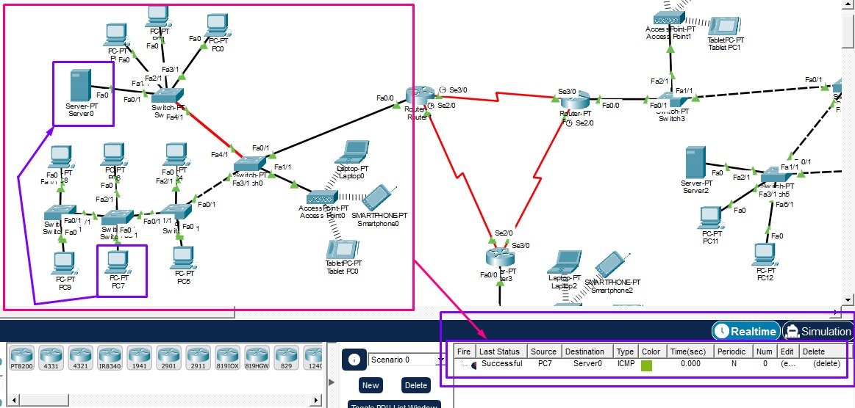
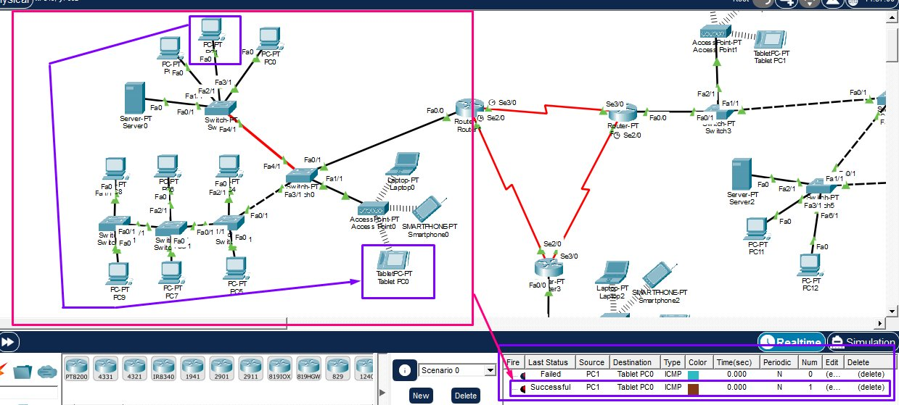
Testing — Inter-VLAN: Branch A (PC → Server & PC → Wireless)
Testing
✅ Branch A: PC7 (VLAN 10) → Server0 (VLAN 20): Successful — Inter-VLAN routing working
✅ Branch A: PC1 (VLAN 10) → Tablet PC0 (VLAN 30): Successful — Wi-Fi VLAN reachable
BIT2154 | Network Design & Architecture | Assignment 2

Slide 34
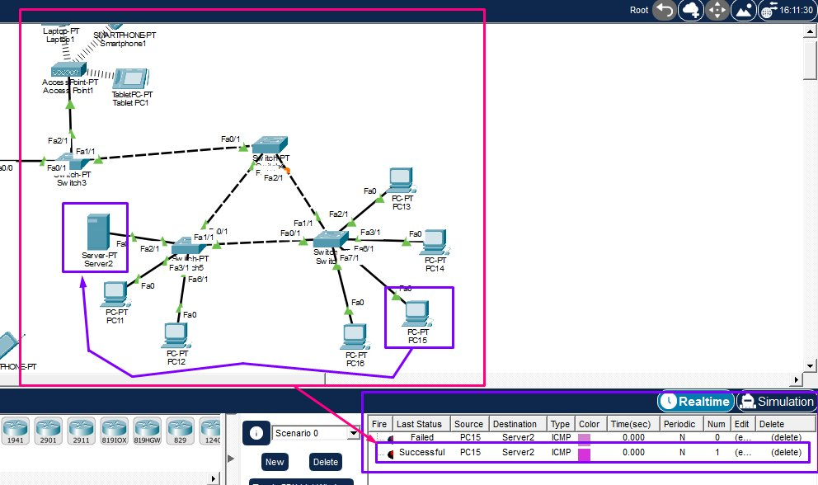
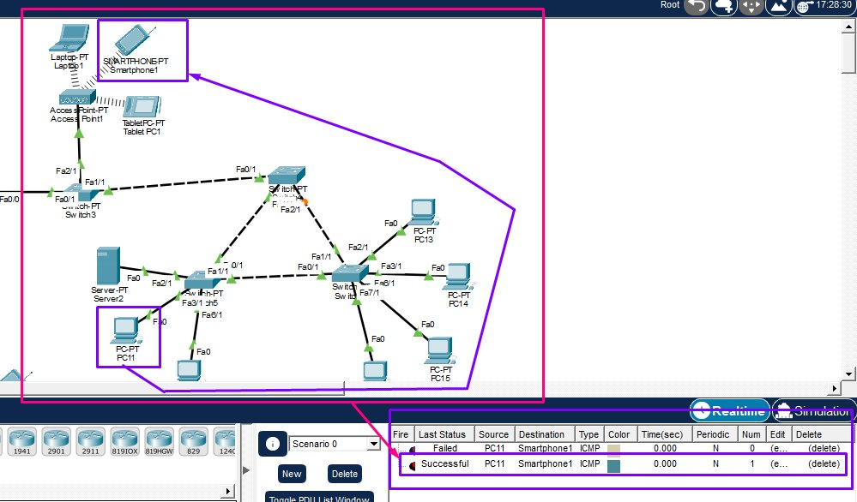
Testing — Inter-VLAN: Branch B (PC → Server & PC → Wireless)
Testing
✅ Branch B: PC15 (VLAN 10) → Server2 (VLAN 20): Successful
✅ Branch B: PC11 (VLAN 10) → Smartphone1 (VLAN 30): Successful
BIT2154 | Network Design & Architecture | Assignment 2

Slide 35
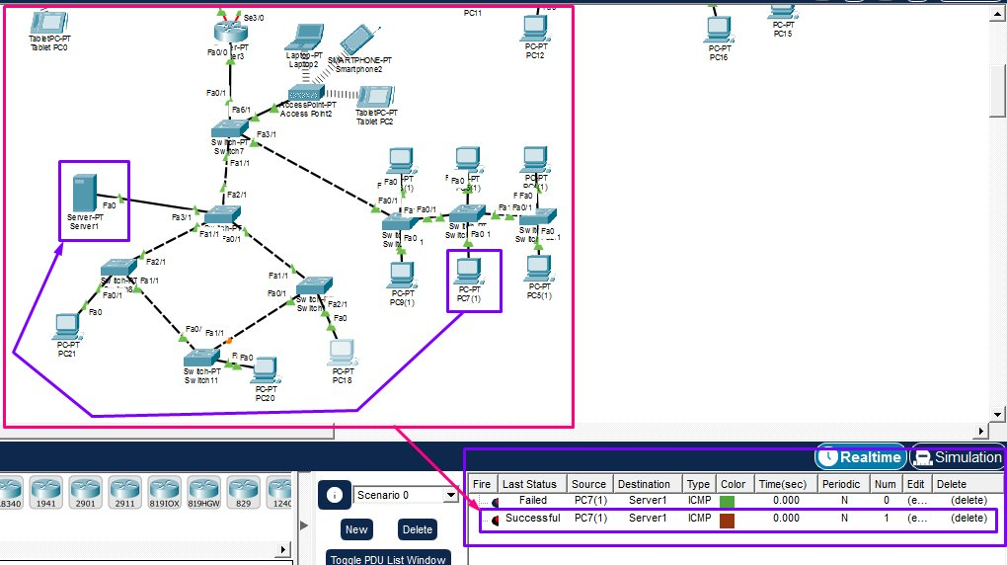
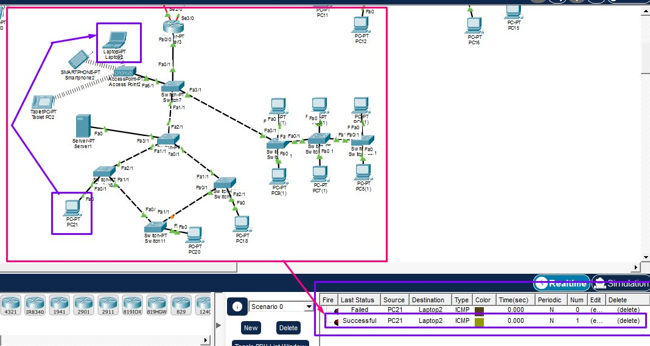
Testing — Inter-VLAN: Branch C (PC → Server & PC → Wireless)
Testing
✅ Branch C: PC7(1) (VLAN 10) → Server1 (VLAN 20): Successful
✅ Branch C: PC21 (VLAN 10) → Laptop2 (VLAN 30): Successful
BIT2154 | Network Design & Architecture | Assignment 2

Slide 36
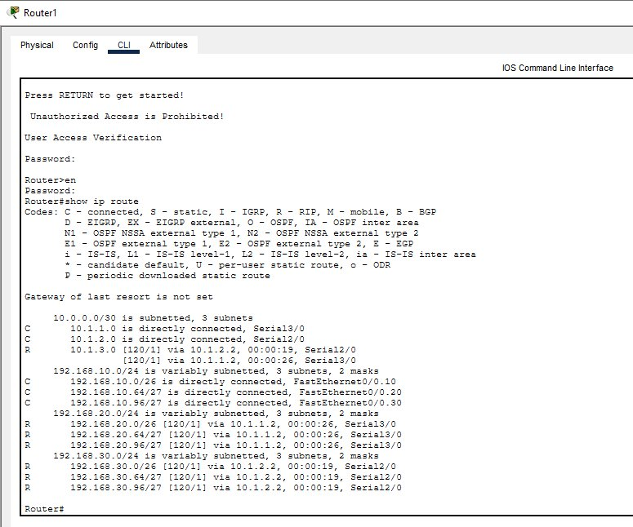
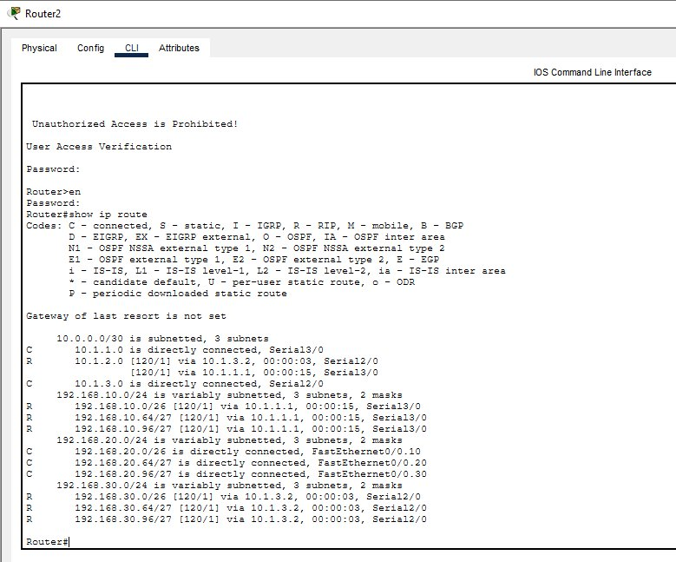
Testing — Routing Table: Branch A (Router1)
Testing
Router1: C=directly connected (own VLANs + WAN); R=RIP routes to Branch B (192.168.20.x) & C (192.168.30.x) via serial links
Router2: C=directly connected (own VLANs + WAN); R=RIP routes to Branch A (192.168.10.x) & C (192.168.30.x)
BIT2154 | Network Design & Architecture | Assignment 2

Slide 37
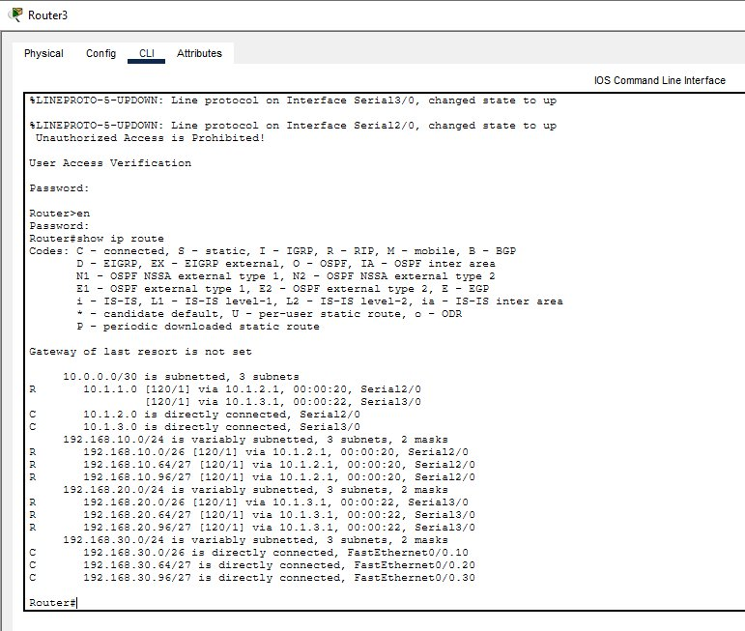
Testing — Routing Table: Branch C (Router3)
Testing
Router3: C=directly connected (192.168.30.x VLANs + WAN links); R=RIP learned routes to Branch A (192.168.10.x) & Branch B (192.168.20.x).
BIT2154 | Network Design & Architecture | Assignment 2

Slide 38
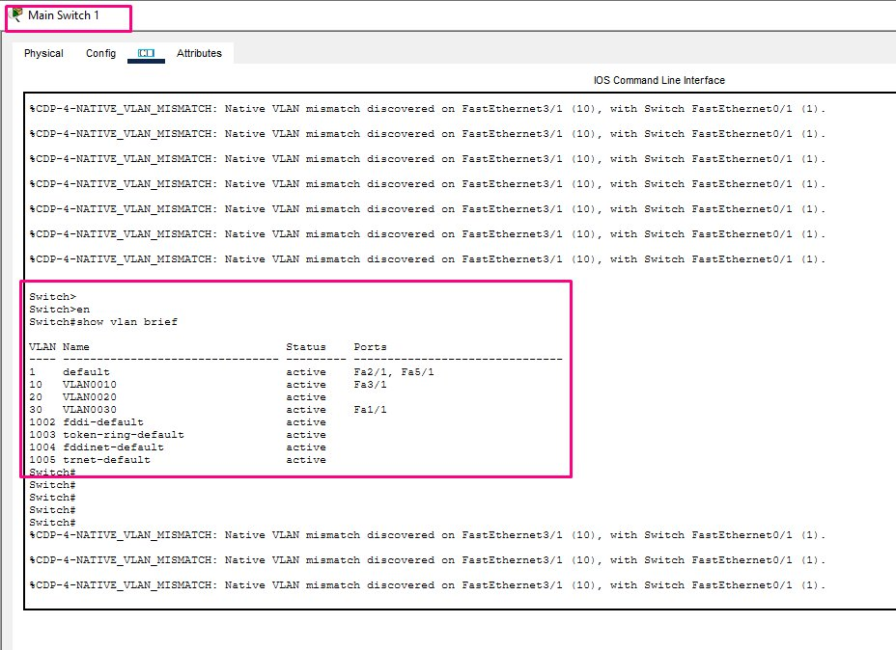
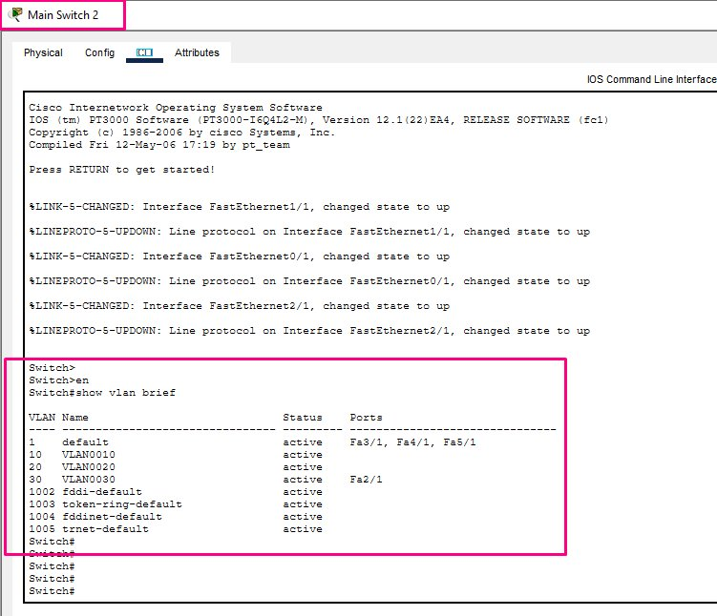
Testing — VLAN Table: Branch A & Branch B Main Switches
Testing
Branch A Main Switch: VLAN 10 (fa3/1), VLAN 30 (fa1/1) active; fa0/1 & fa4/1 as trunk
Branch B Main Switch: VLAN 10, 20, 30 created; fa2/1=VLAN30 (Access Point) active
BIT2154 | Network Design & Architecture | Assignment 2

Slide 39
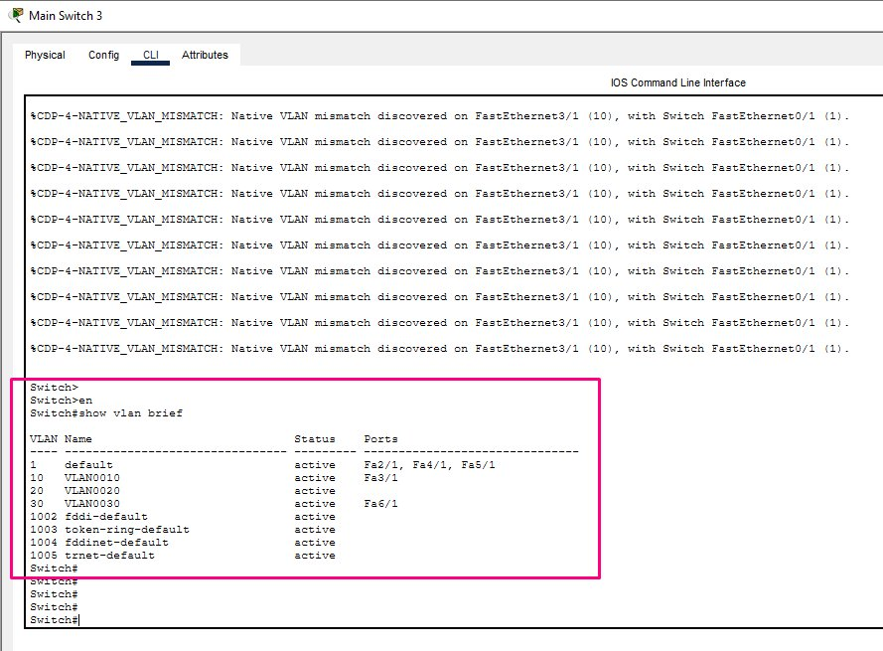
Testing — VLAN Table: Branch C Main Switch
Testing
Branch C Main Switch: VLAN 10 (fa3/1 active), VLAN 20, VLAN 30 (fa6/1 active) all confirmed present. Trunk ports correctly configured.
BIT2154 | Network Design & Architecture | Assignment 2

Slide 40
08. CONCLUSION
Summary & Reflection

Slide 41
Conclusion
Summary
Findings
Reflection
✅ All three branches successfully implemented in Cisco PT ✅ VLAN 10/20/30 correctly segmenting PCs, Servers, and Wi-Fi users ✅ Inter-VLAN routing via Router-on-a-Stick (dot1Q) working across all branches ✅ RIP Version 2 enabling full inter-branch connectivity ✅ Security measures applied: encrypted passwords, banner, port security, unused port shutdown
This assignment deepened understanding of real-world network implementation. Key lessons learned: Subnetting requires careful planning to avoid overlapping networks across VLANs and branches. Trunk vs Access ports — misconfigurations (Native VLAN mismatch) cause connectivity issues and must be resolved. RIP v2 with no auto-summary is essential for classless routing in a multi-subnet environment. Security is not optional — even basic configurations like port security and password encryption significantly harden the network.
BIT2154 | Network Design & Architecture | Assignment 2

Slide 42
Thank You
Network Design & Architecture | BIT2154 | Assignment 2
January 2026 Semester | SEGi University

